Slide 1

IEEE PROJECT
A DATA ANALYTICS SUITE FOR EXPLORATORY PREDICTIVE

Slide 2
OBJECTIVE
Objective: Develop an IEEE-compliant Data Analytics Suite for Type 2 Diabetes, focusing on exploratory data analysis, predictive modeling, and risk factor identification. The suite aims to provide a user-friendly, interactive dashboard for real-time analysis, ensuring scalability, robustness, and adherence to ethical considerations. By integrating with healthcare systems, the project seeks to facilitate collaboration among stakeholders, enabling evidence-based decision-making for diabetes prevention and management.

Slide 3
METHEDOLODY
1. Prediction
2.Data Visualization
Basic visualization
Probability
Heatmap
Accuracy
Linear Regression
3. Results

Slide 4
Library used
import pandas as pd
pandas:Library for data manipulation and analysis.
from sklearn.model_selection import train_test_split
train_test_split: Function to split data into training and testing sets.
from sklearn.preprocessing import StandardScaler
StandardScaler: Class for standardizing features.
from sklearn.ensemble import RandomForestRegressor
RandomForestRegressor: Class for a random forest regression model.
from sklearn.metrics import mean_squared_error, r2_score
mean_squared_error and r2_score: Metrics for evaluating regression models.

Slide 5
Prediction
A prediction model is a mathematical or computational representation of a real-world process or phenomenon that aims to forecast or estimate future outcomes based on past data or known information. In simpler terms, it's like a tool that learns from examples to make predictions about new, unseen situations.

Slide 6
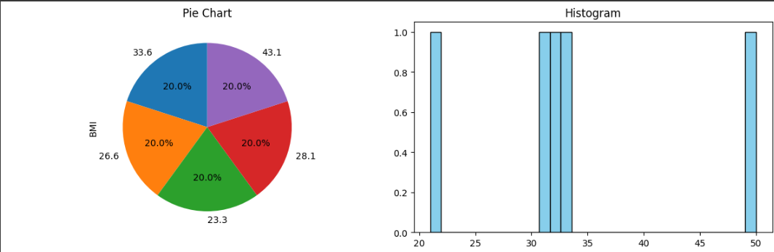
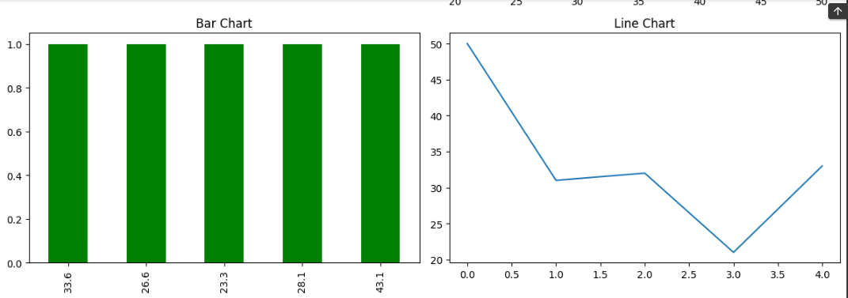
Data visualization
https://colab.research.google.com/drive/1xN7sWyJ2ebU1L4NR6odpUIfFPV2ut7ud?authuser=7#scrollTo=0aNTGrfdzLpL&line=1&uniqifier=1
Output:

Slide 7
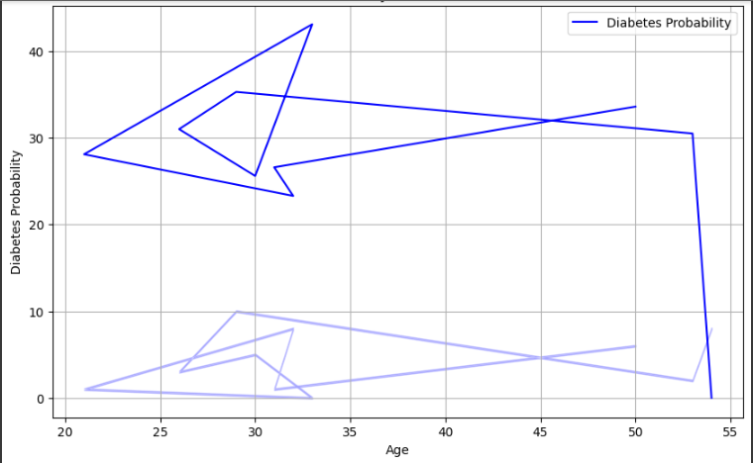
Probability
https://colab.research.google.com/drive/1xN7sWyJ2ebU1L4NR6odpUIfFPV2ut7ud?authuser=7#scrollTo=ZOvP1XahvUVa&line=4&uniqifier=1
Output:

Slide 8
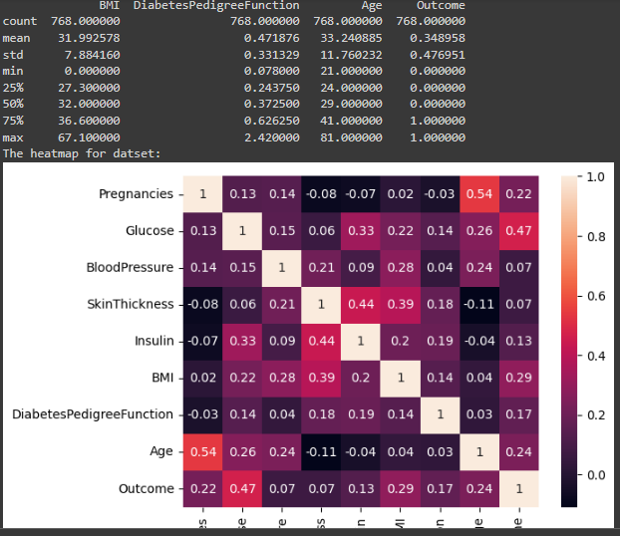
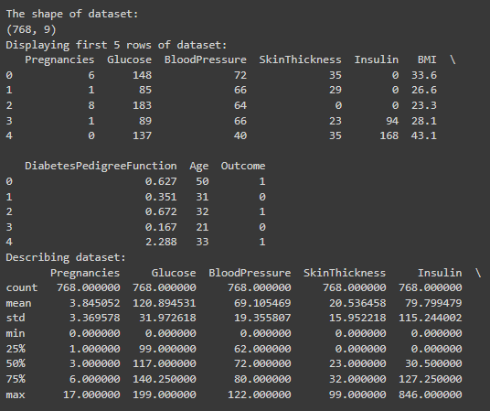
Heatmap
https://colab.research.google.com/drive/1xN7sWyJ2ebU1L4NR6odpUIfFPV2ut7ud?authuser=7#scrollTo=ZOvP1XahvUVa
output:

Slide 9
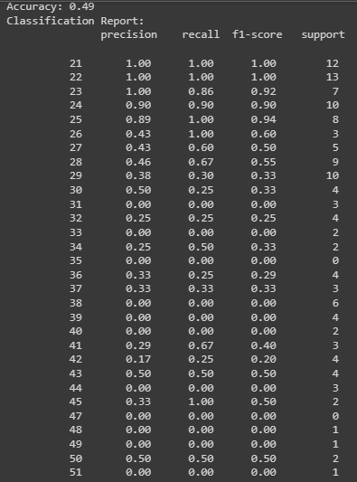
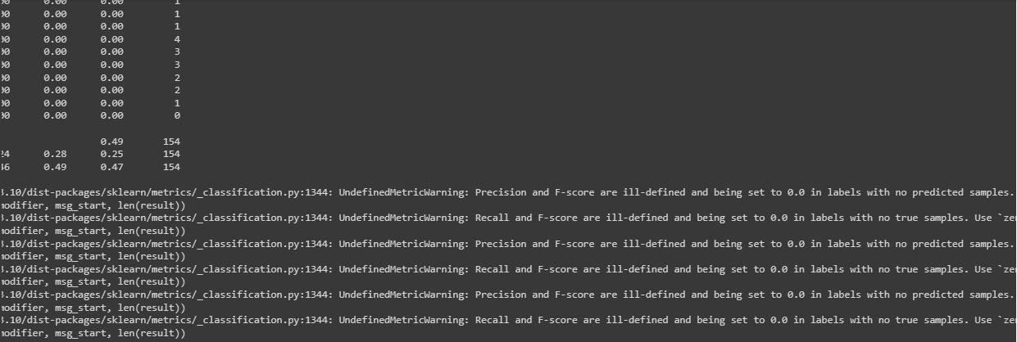
Accuracy
https://colab.research.google.com/drive/1xN7sWyJ2ebU1L4NR6odpUIfFPV2ut7ud?authuser=7#scrollTo=oP4lB8xz0JJ4&line=6&uniqifier=1
Output:

Slide 10
Linear Regression

Slide 12


